Slide 1
Head Lines
What is Next
Implementation
Our Role
Presentations

Slide 2
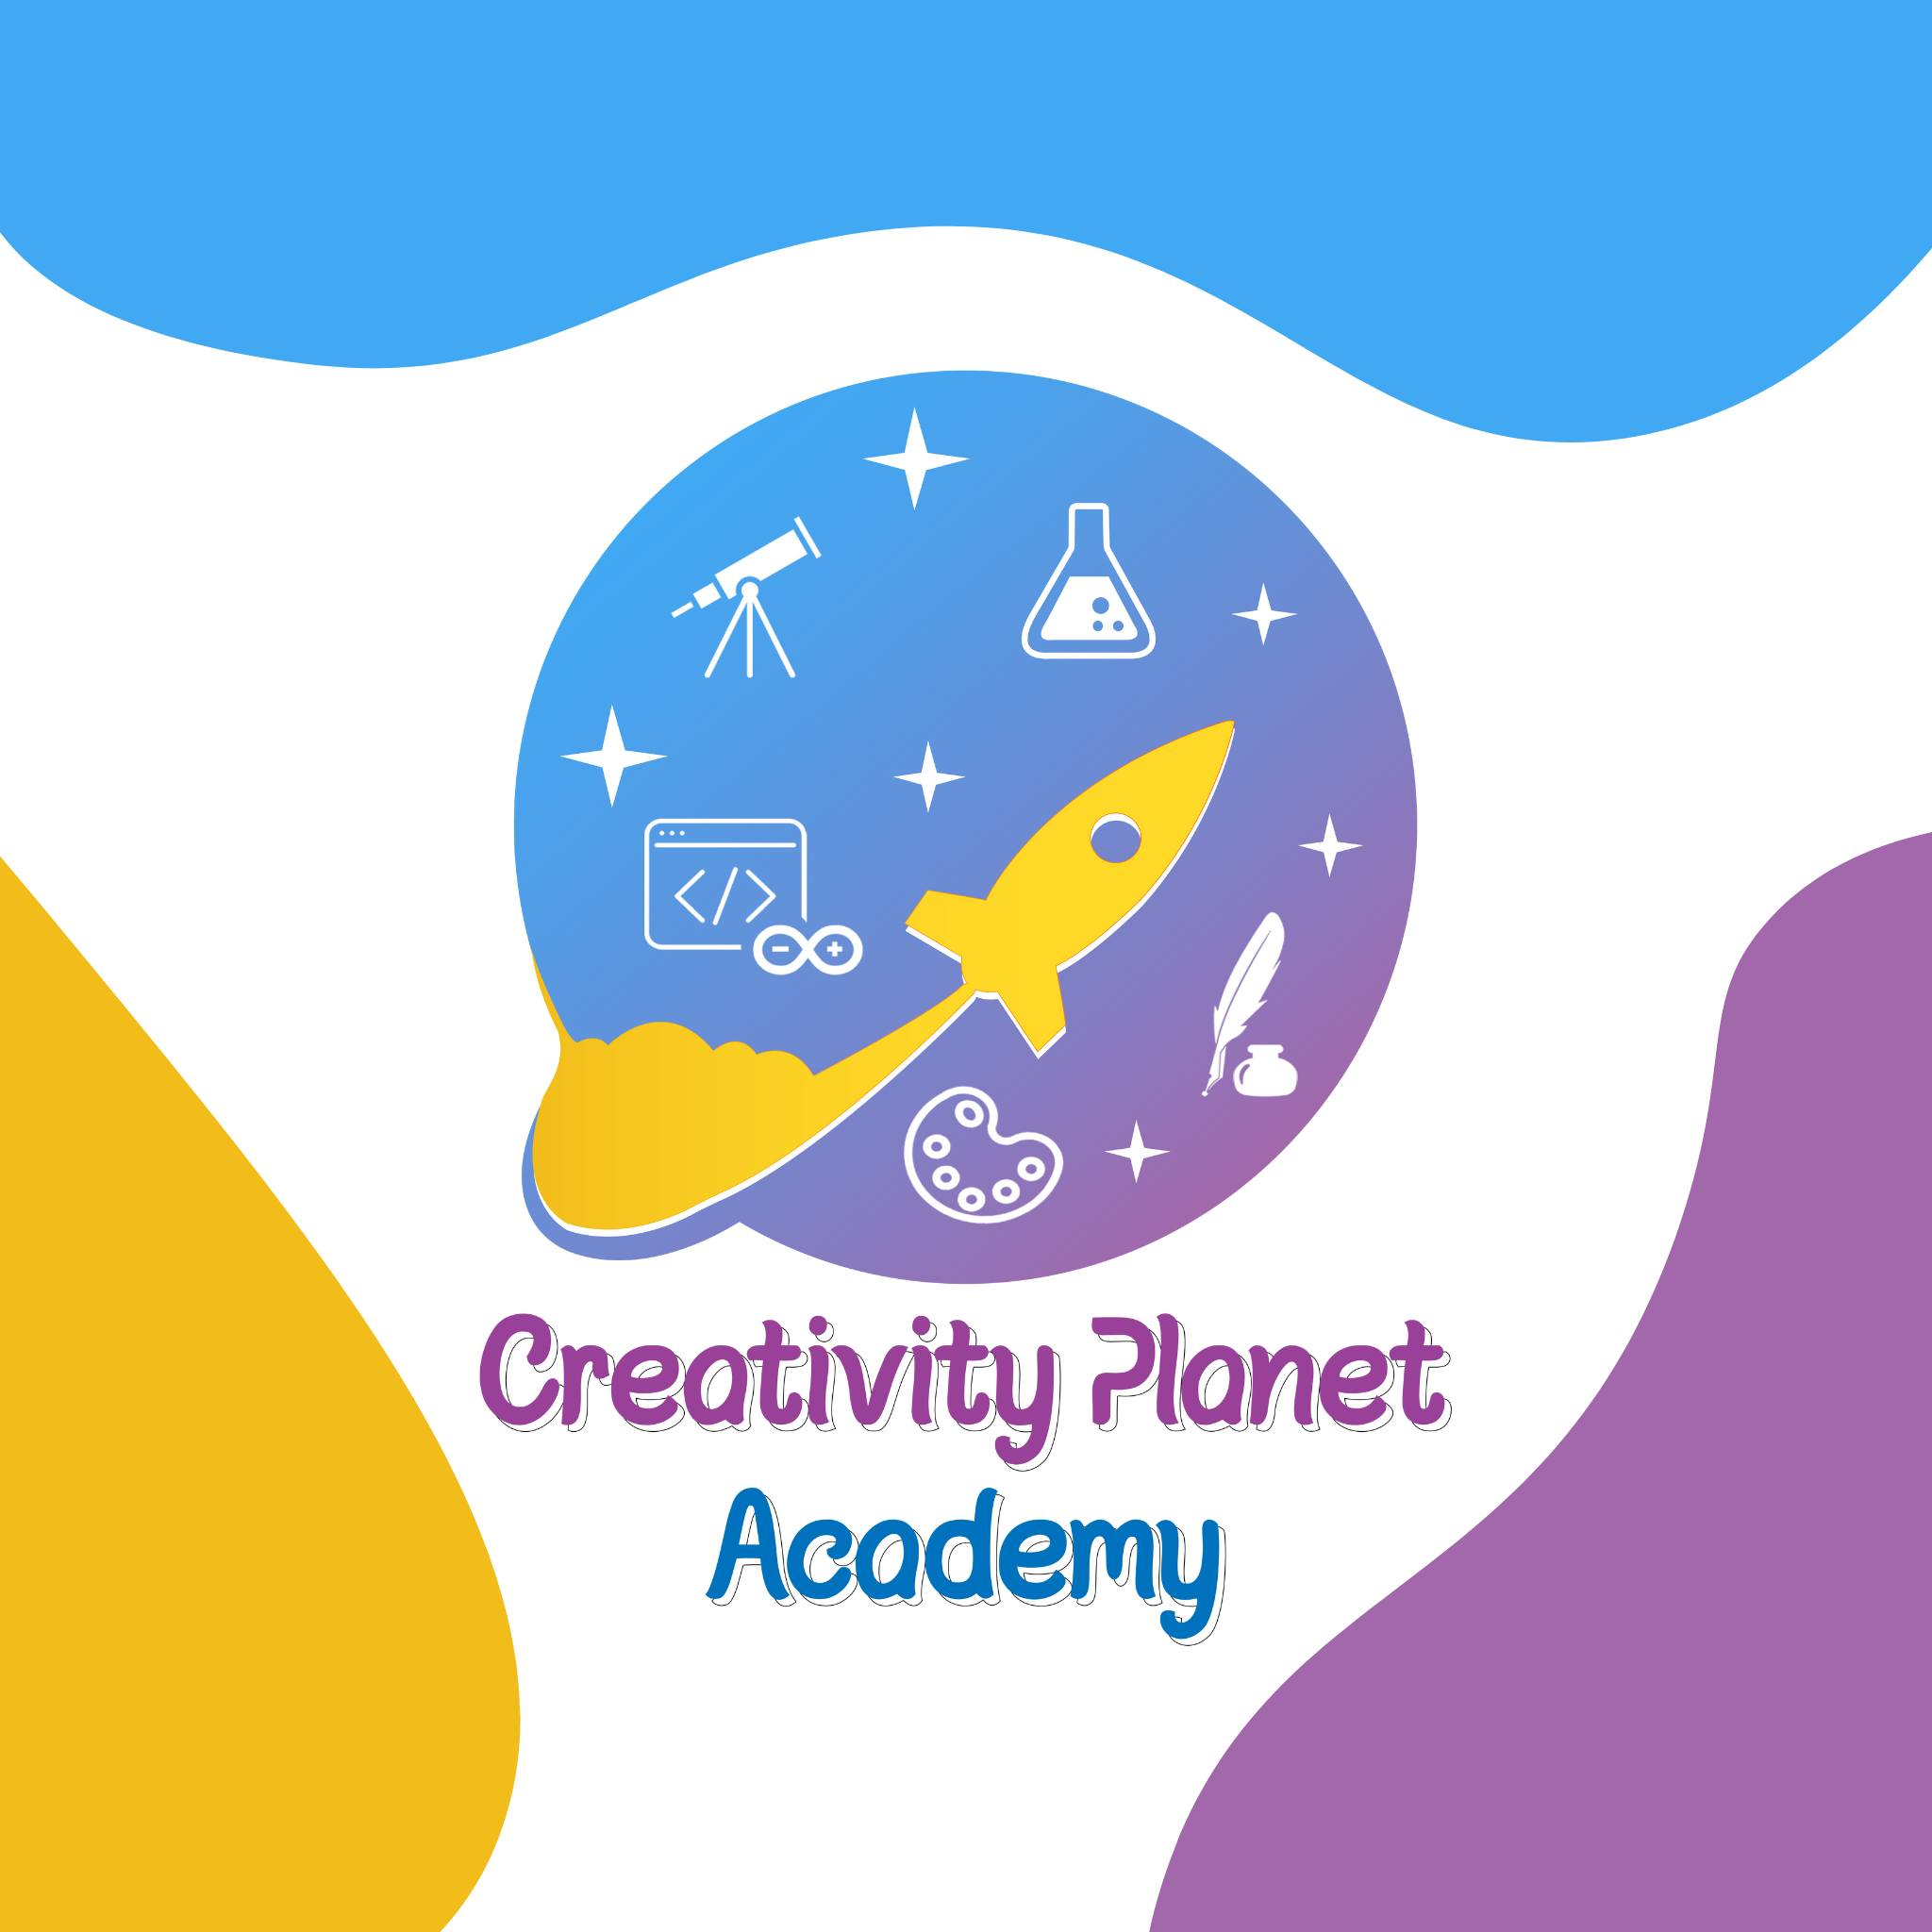
CREATIVITY
PLANET ACADEMY
WE BUILD FUTURE CREATORS

Slide 3
CREATIVITY PLANET
1
CREATIVITY PLANET Academy
NEXT STEP
Brief About Academy
STEAM Education
STORY
2
The Academy Role
STEAM Camps
Other Types Of Camps
CAMPS
3
Academy success story
BRIEF
Why is Age
Sample Our Camps
4
mission, vision, and goal
- The Academy Next step

Slide 4
CREATIVITY PLANET
Is a planet For your Kids which give the kid an interaction with every part in an isolated protected planet. Its goal is to Build a successful and leadership personality

Slide 5
STEAM Education
based on interdependence between the branches of science
SCIENCE
The study of the natural world, including physical, chemical, and biological sciences.
TECHNOLOGY
ART
The use of tools, machines, and computer systems to solve problems and improve the world.
SCIENCE
ENGINEERING
The application of scientific and mathematical principles to design and build new technologies and systems.
ARTS
TECHNOLOGY
The expression of creativity through various forms of art, such as music, painting, sculpture, and dance. Expression of creativity through various forms of art, such as music, painting, sculpture, and dance.
MATH
MATH
Text Here
The study of numbers, quantities, and shapes, and their relationships with each other.
Engineering

Slide 6
CAMPS
More Than one for Your Kid
STEAM CAMP
CHAMPION
SAFARY
LANGUAGES
A STEAM camp for children is a fun and interactive program that combines science, technology, engineering, arts, and mathematics to foster critical thinking, creativity, and problem-solving skills in a collaborative environment.
A champion camp for children is a program that focuses on developing physical and mental abilities through sports, games, and fitness activities, with a focus on building confidence and leadership skills in a fun and supportive environment.
A safari camp for children is an outdoor educational program that provides fun and interactive opportunities for kids to learn about wildlife, nature, and conservation, and develop a deeper appreciation for the natural world.
A languages camp for children is an educational program that provides an immersive and fun environment for kids to learn and practice different languages, with a focus on developing fluency and cultural understanding.

Slide 7
Academy success story
Why the first five years of your child’s life are the most important
Why this Age, is 5 year is good?
“CRITICAL YEARS”
During this time, babies’ brains are growing and they are learning to interact with the world around them.
Create strong relationships
Learning through play
Feed their natural curiosity
Find the right environment for your child to develop

Slide 8
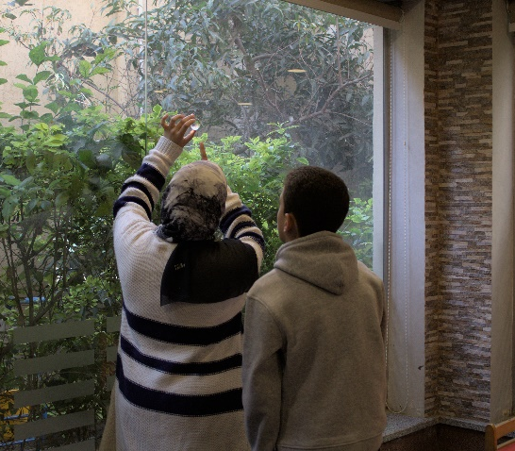
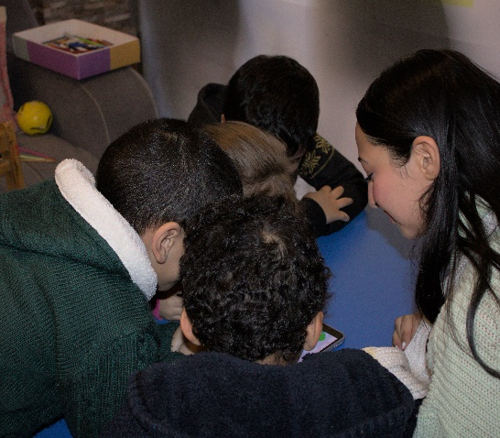
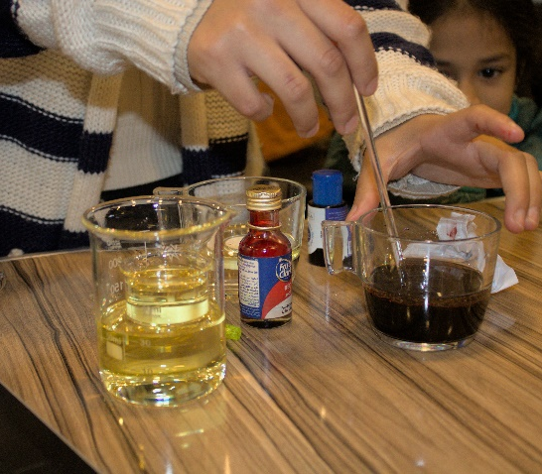
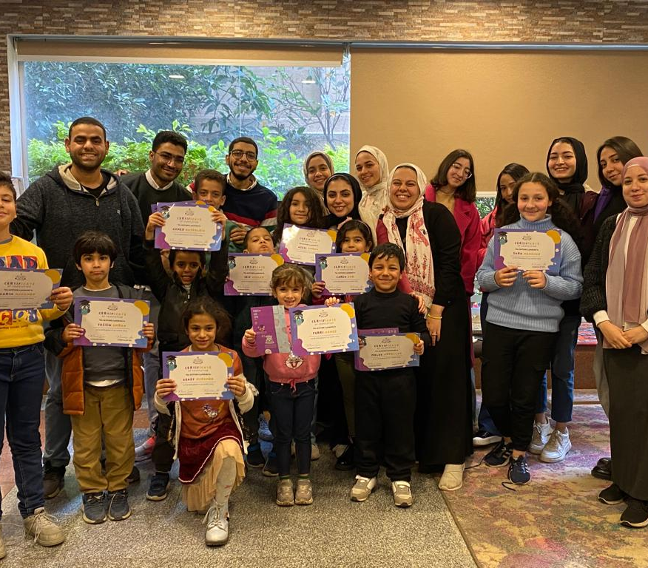
Academy success story
we all connected together for your kids
Exploring
Team Work
Hand skills
Showing honor
Children learn to explore new things And ask questions
Children work in teams to develop their cooperation
Children use their hands to build things in their way
Certificates are distributed at the end of each camp

Slide 9
Mission
An academy specialized in developing children's skills and helping them discover and develop their passion to facilitate their life choices in the future, through the STEAM educational system.
Offline
Vision
Online
We aim to establish a comprehensive, purposeful, and encouraging educational system for children that is also safe for mothers.
Information technology
Goal
Our goal is to build a comprehensive educational platform for mothers and children throughout the Arab world that serves as a community for them

Slide 10
CREATIVITY
PLANET ACADEMY
contact at creativeplanet@gmail.com

